Slide 1
Turbo Stack
Notes:
Smart Inventory Management System. Predicts the Sale of any product for any point of time. Lets the company know about the shortage. Lets the manufacturers know about that shortage.

Slide 2
Group No. 19
Project Guide: Prof. Prachi Kshirsagar
Group Members: Idris Barwaniwala Kaustubh Deshpande Sourav Dubey

Slide 3
Abstract:
Inventory prediction aims to forecast the demand of a specific item in the future and track the amount of items based on the predicted results. A precise and well grounded inventory prediction can avoid complications such as product overstocking, dead-stock, under-stock and greatly minimize the maintenance cost. Data in inventory is a type of time series data, which has its own attributes of huge volume, broad covering range, increased time span and considerably low regularity. The existing inventory prediction methods usually only consider the immediate data or similar items historical data and achieve prediction by calculating the past average, which cannot capture the complicated attributes, such as long term trend, short term trend, periodic trend, and special events like festive trends. In this approach, we consider inventory management as a data mining problem and propose a multi step dynamic forecasting model, which first adopts multiple machine learning techniques and combines them with time series analysis methods to obtain a prediction basis, then takes multiple factors of inventory into consideration to fulfil a dynamic inventory prediction. The dynamic prediction model is incorporated into a smart inventory management system. The probationary results and practical implementation illustrates the potential and efficiency of our proposed system.

Slide 4
Introduction:
Prognosticating inventory is one of the main components in inventory management for huge retail companies. In general, prognosticating inventory often refers to demand forecasting, which is the forecast activity of evaluating the quantity of a product or service that customers will purchase. Performing an accurate demand forecasting can significantly minimize the dead-stock inventory and reduce the risk of cessation.
In the current retail market(e-commerce), purchase has become more frequent and intricate. As a repercussion, a large amount of data regarding stocked inventory items will be created everyday. The growing volume and long time span of such data make it difficult to manually manage the inventory. In addition, the corresponding relation among inventory items becomes composite (e.g. some items’ sales amount may be affected by others), such associations further increases the difficulty of efficient inventory forecasting.
The existing solution to this problem is often accomplished by calculating past averages, which have very limited potential of intelligent analysis. However, the demand of a specific item is determined by not only immediate collation, but also a list of aspects, such as trends, seasonality, and special occasions. Thus, how to establish a much more precise and optimal forecasting method reducing prediction mistakes is urgently expected by many large retailing companies.

Slide 5
Aim:
Objectives:
TurboStack is a software that, with the help of appropriate machine learning algorithms, predicts the quantity of any product from the product line needed to be stored in the warehouse for a particular period of time.
Reduce duplicate ordering of stock for inventory
Eliminate delay in stock processing
Maintains accurate number of products required
Automatic updates on item status regarding inventory

Slide 6
Problem statement:
The primary object is to provide a system to help businesses better manage the inventory which would in turn lead to a stable supply chain procedure. A major part of the system will be using algorithms to find out the approximate amount of time until when the current inventory would be useful and predicting the number of units required for the next iteration.

Slide 7
Scope of the project:
Having a very good Inventory Management system and Supply Chain also needs the proper implementation in a company. Turbo stack is an application that helps keep better inventory by managing it for you. TS would analyze the pattern during the inventory depletion and accordingly send orders to the manufacturers for the replenishment. Different parameters such as time taken by the manufacturer to make the products, delivery time, setbacks during the delivery, would be taken into considerations

Slide 8
Literature survey:
Forecasting for the time series sales data of fashion products is crucial for many fashion companies. However, both the traditional statistical methods and the more advanced intelligent artificial intelligence (AI) methods suffer serious drawbacks in which the former’s performance depend highly on the time series data’s features whereas the latter ones are slow. There is hence a need to call for the development of an intelligent time series forecasting system which is fast, versatile and can achieve a reasonably high accuracy.
Time series prognostication may be a classic topic and sales forecasting has been a vital part of several fashion companies. Despite the very fact that there's no “perfect” forecast, forecasting for extremely structured statistic (e.g., the one with high seasonality or trend) is understood to be “easy” as a result of there are several well-established models which give the needed analytical formulations as an example, Hott develop analytical models with closed-form expressions for forecasting statistics with outstanding options of seasonality and trend by victimization the exponentially weighted moving average technique. Additionally, applied math ways like SARIMA and ARIMA have additionally been widely applied for these structured prognostication issues with smart performance.

Slide 9
However, for fashion firms, the statistics for sales data are ill-famed for being extremely volatile and it's terribly difficult, if not possible, to analytically study the underlying pattern and thus the well-established and traditional applied math ways can fail to create a sound prediction for them. As a result, recent advances of artificial intelligence (AI) technologies have provided the choiceway of providing precise and additional correct prognostication results for fashion sales statistics. as an example, Au et al. explore the style sales prognostication drawback for fashion retailers by victimization organic process neural networks (ENN). They find that ENN will considerably enhance the prognostication accuracy compared to numerous different ancient ways.
Although AI ways like ENN will manufacture extremely accurate prognostication results for volatile fashion sales time series, they suffer a significant downside within which they're slow (e.g., ENN will take hours so as to come up with the prognostication results). This defect becomes a significant barricade that hinders the appliance of AI ways for fashion sale forecasting on the planet. lastly, within the literature, there are some innovative proposals from totally different perspectives for establishing intelligent quick prognostication for different sorts of applications. Several of those projected methods are exalting and may result in several promising future research.

Slide 10
Limitations of the existing system:
Existing systems have a huge amount of human time dependency.
The improper use of an ERP system would lead to false data prediction.
Faulty predictions leading to stale inventory.

Slide 11
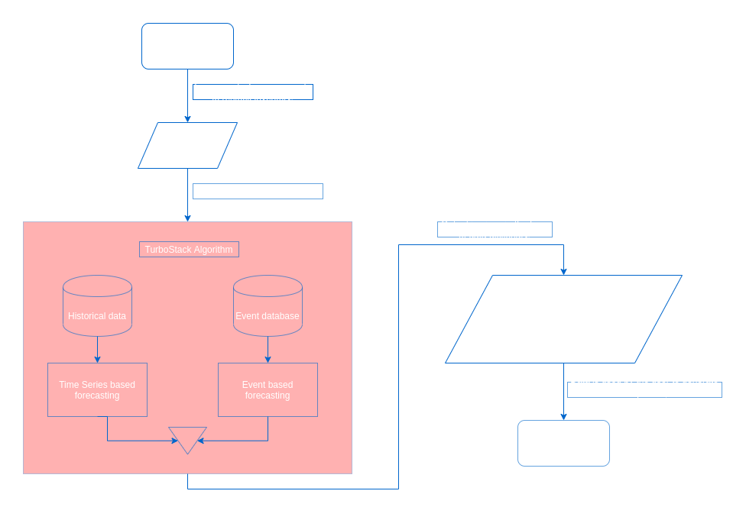
Project Flowchart:

Slide 12
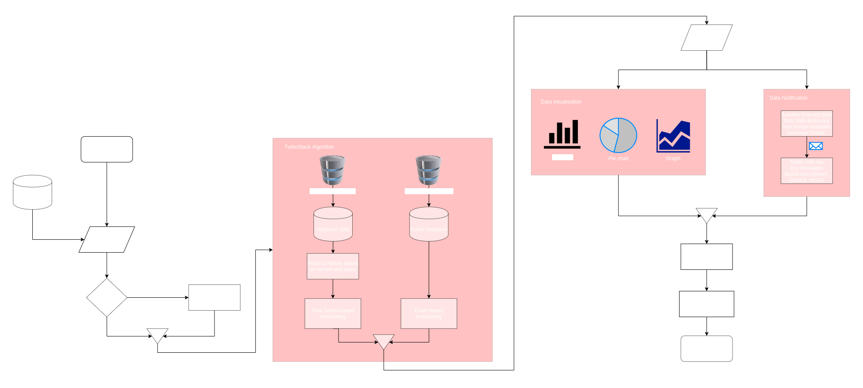
System architecture:

Slide 13
Proposed systems:
In our proposed system we use a linear regression algorithm and use one of its applications commonly known as “Time Series forecasting” with slight modification, which is more suitable for this project. In time series forecasting a graph is plotted of sales against time (one of its many applications to predict future sales). Plotting this graph can help you predict future sales easily.
But in some cases, plotting just the graph of these two variables might not be the best approach. Sales of E-commerce websites can be highly unpredictable because of their dynamic nature. For an ethnic wear website whose sales are driven by the events and festivals. So, taking events along with time and plotting the graph against sales can give better results. This approach improved the accuracy of our model.

Slide 14
Linear Regression:
Linear regression is a basic method of predictive analysis and is widely used. Does a set of predictor variables do a good job in predicting an outcome (dependent) variable?
There are several terms for dependent variables of a regression. This can be referred to as variable outcome, variable criteria, endogenous variable, or regress and. Exogenous variables, predictor variables, or regressors can be called independent variables.
Three main uses for regression analysis are:(1) determining the strength of predictors, (2) forecasting an effect, and (3) trend forecasting.

Slide 15
Time Series Forecasting:
Time series Forecasting is one of the most applied data science techniques in business, used extensively in finance, in supply chain management and in production and inventory planning, and it has a well-established theoretical grounding in statistics and dynamic systems theory.
Time series methods forecast solely on the demand history of the item you are forecasting. It works by collecting trends in the historical data and extrapolating those patterns into the future. Methods of the time series are ideal when you can presume a reasonable amount of continuity between past and future. They are ideally suited for short-term prognosis (say 18 months or less).This is because they assume future patterns and trends will resemble current patterns and trends. This is a reasonable assumption in the short term but the further out you predict becomes more tenuous.
A time series is usually modelled through a stochastic process Y(t), i.e. a sequence of random variables.[9] In a forecasting setting we find ourselves at time t and we are interested in estimating Y(t+h), using only information available at time t.

Slide 16
Event Model:
A time series forecasting approach is a predictive technique focused solely on the history of the object to be forecast. Time series methods tend to work quite well when demand for an item is driven by factors such as sales levels, trends, and seasonal patterns.However, business data contain responses to events that can not be captured as part of the stage, trend and seasonal components. Examples include product promotions, moveable holidays, business interruptions and other unusual occurrences. When these types of events drive a large amount of demand, the time series approaches won't work very well.
An event model is a predictive method designed to quantify the impact of events and to use this information to improve predictions. The input for an event model is both the historical demand for the item to be predicted and a schedule listing the timing of any historically occurring events and (if applicable) the timing of any future events to occur in the forecast period.
An event model is a statistical tool for quantifying the effect of events and using this knowledge to enhance predictions. The input for an event model is both the historical demand for the element to be expected as well as a schedule listing the timing of any historically occurring events and (if applicable) the timing of any possible events to occur over the forecast period.

Slide 17
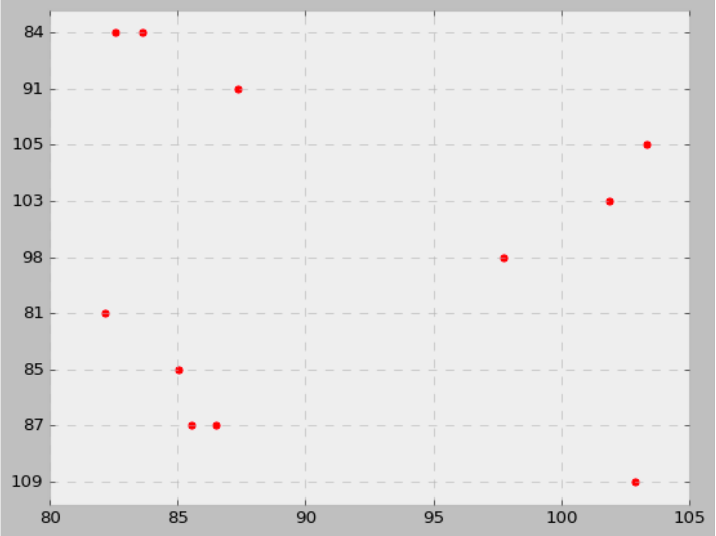
Output points plotting on graph:

Slide 18
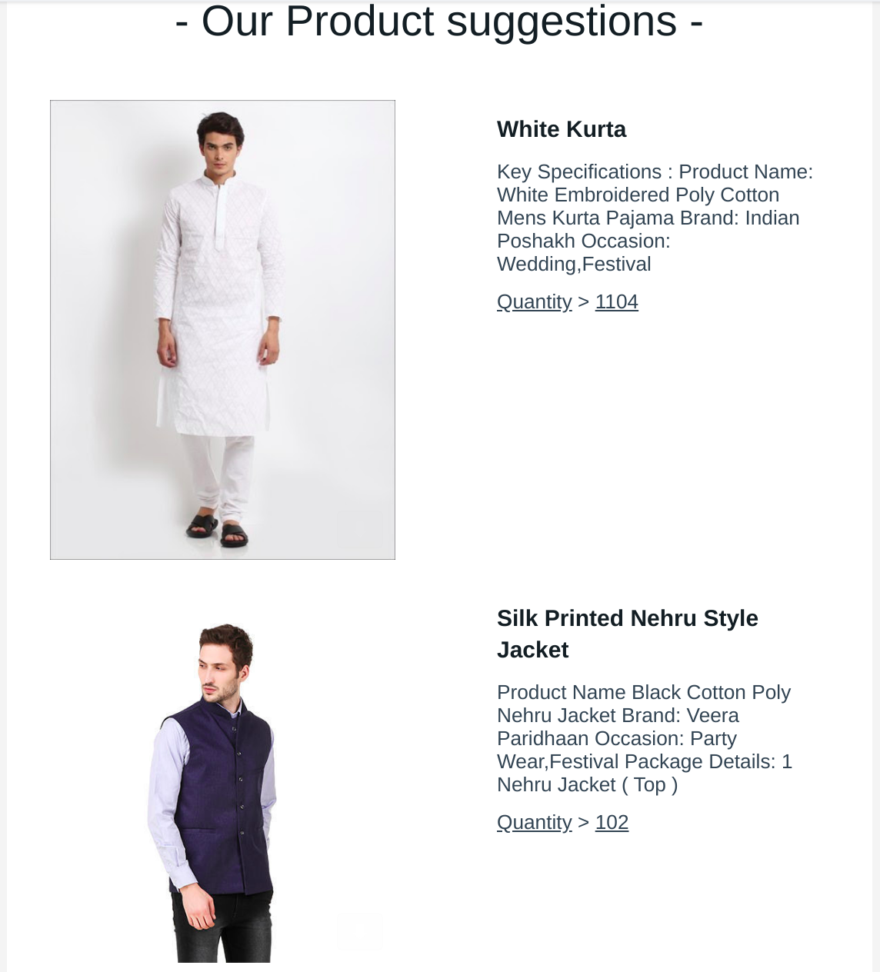
User email notification:

Slide 19
Conclusion:
The idea of adapting AI based inventory control systems to make the company supply chain process cheaper, faster and easier is a compelling one in modern industries. Making the supply chain process cheap and quick, normalizes it in the eyes of the customers, removes a certain power barrier of product out of stock. It also opens the door for a more organized business process, allowing management to focus more over what’s truly important and invest their time in individual product analysis.
We introduced a unique, AI-based inventory management system that utilizes smart algorithms to enable fast and cost efficient inventory management while guaranteeing improvement in supply chain process. We have outlined the systems architecture, the design, and accuracy of the system. By comparison to previous work, we have shown that the linear regression technology offers a new possibility for companies to advance from the existing manual excel management, to a more cost- and time-efficient management system, while increasing the sales by banishing out of stock problems.

Slide 20
References:
Holt, C. C., “Forecasting seasonals and trends by exponentially weighted moving averages”, International Journal of Forecasting, Vol. 20, pp.5-10, 2004.
Choi, T.M., Yu, Y., K. F. Au., “A hybrid SARIMA wavelet transform method for sales forecasting”, Decision Support Systems, Vol. 51, pp.130-140, 2011.
Willis, H.L., Parks, T.W., “Fast algorithms for small area electric load forecasting”, IEEE Transactions on Power Apparatus and Systems, Vol. PAS-102, No. 10, October 1983.
Hanke, J.E., Wichern, D.W. Business Forecasting, Prentice Hall, 2009.
INTELLIGENT TIME SERIES FAST FORECASTING FOR FASHION SALES: RESEARCH AGENDA (TSAN-MING CHOI, CHI-LEUNG HUI, YONG YU)
Inventory Management Forecasting Models Techniques , https://www.shipmonk.com
A Two-Step Dynamic Inventory Forecasting Model for Large Manufacturing: https://ieeexplore.ieee.org/document/7424411
What is linear regression?, https://www.statisticssolutions.com/what-is-linear-regression/

Slide 21
Thank you

